Slide 1
FUTURISTIC
B A C K G R O U N D
Current AI robots development

Slide 2
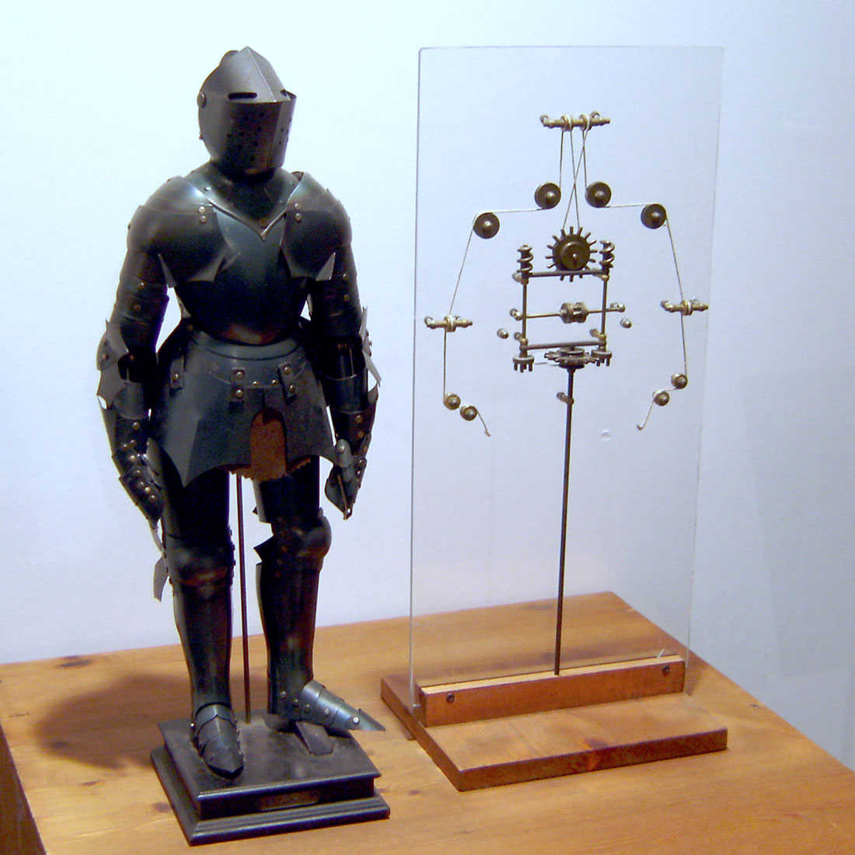
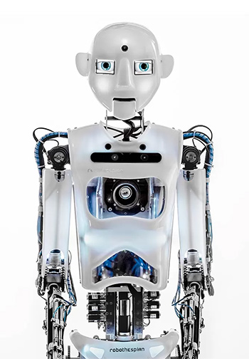
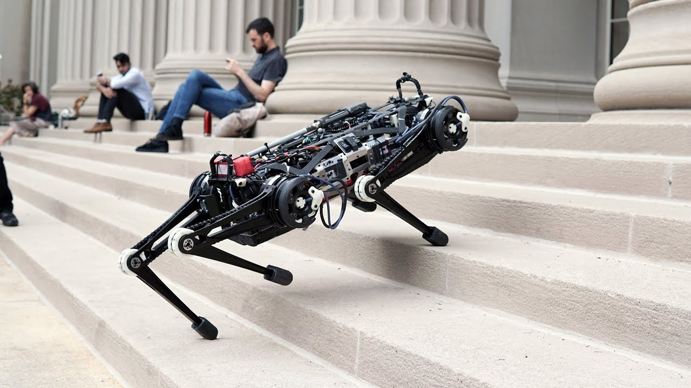
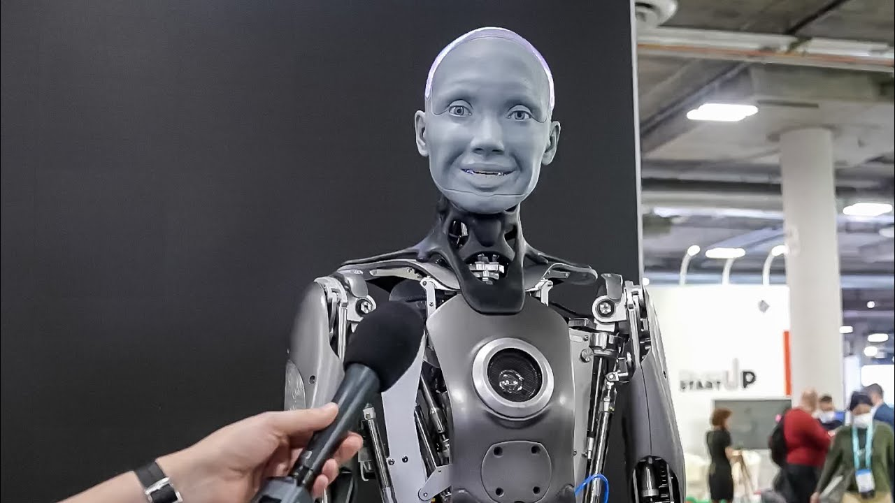
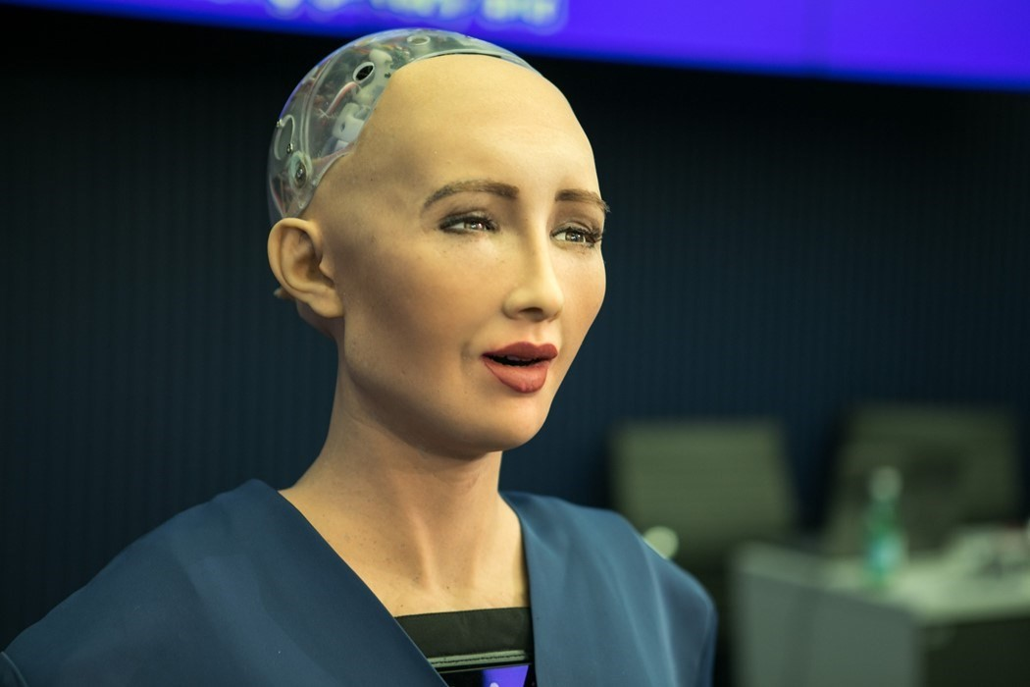
We are here , We are going there.
1) The romur has it that the actual first robot was The Unimate robot in 1954.
Best robots as per today !!!
2) First Robot was Robothespian.
4) Cheater robot from M.I.T.
3) The first robot to resamble a human was Amica from Facebook company.
5) The first robot with credit card, robot right(human-robot rights) is from Hanson Robotics - Sophia the Robot.

Slide 3
Alec Mabhiza Chirawu 亚历克上
Information & Engineering Department
Student ID: M202161029
Terminator 2
Judgement Day

Slide 4
Terminator 2: Judgment Day
Is a 1991 American science-fiction action film directed by James Cameron.
Main Actors of this wonderful movie are : Arnold Schwarzenegger, Linda Hamilton, Robert Patrick, and Edward Furlong.
In its plot, the malevolent artificial intelligence Skynet sends a Terminator—a highly advanced killing machine T-1000—back in time to 1995 to kill the future leader of the human resistance John Connor when he is a child. The resistance sends back a less-advanced T-800, reprogrammed Terminator to protect Connor and ensure the future of humanity.
some criticized the film for its violent content.
It is also seen as one of the most-influential visual effects films of all timeYou can define one of the concepts here
You can define one of the concepts here

Slide 5
“The greatest glory in living lies not in never falling, but in rising every time we fall.”
— Arnold schwarzenegger

Slide 6
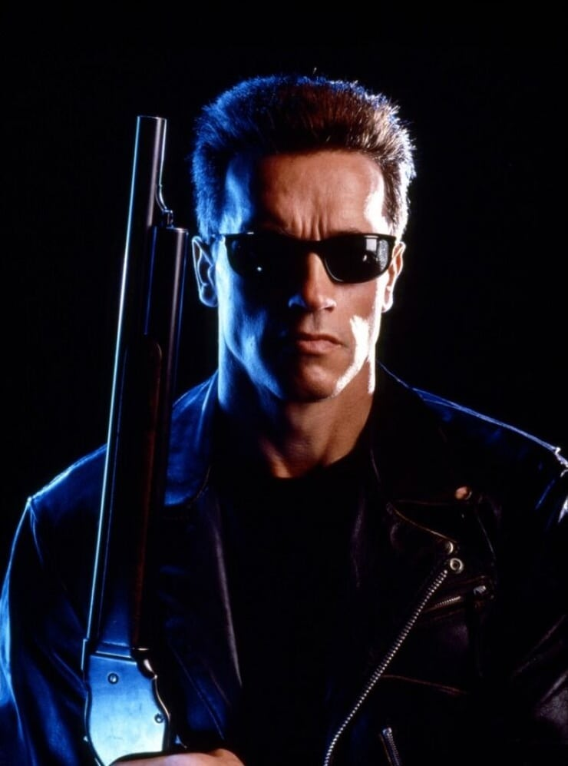
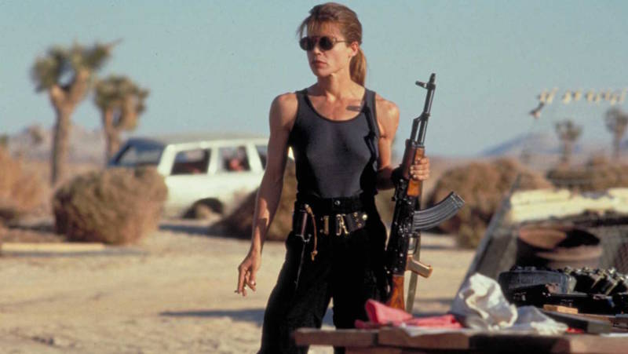
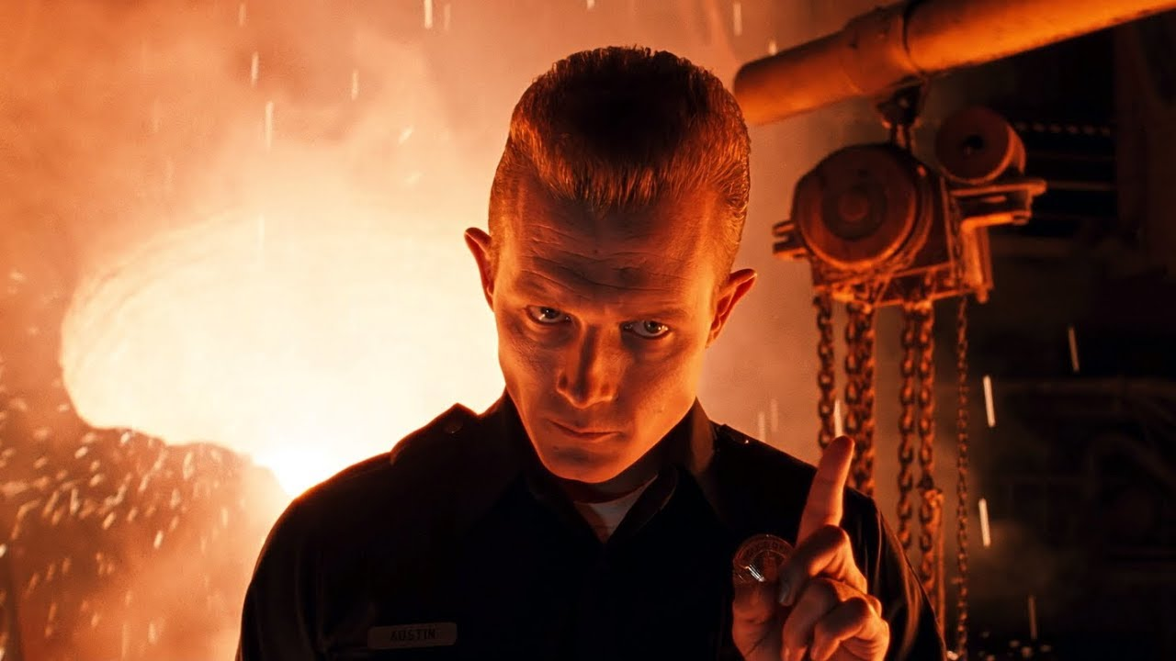
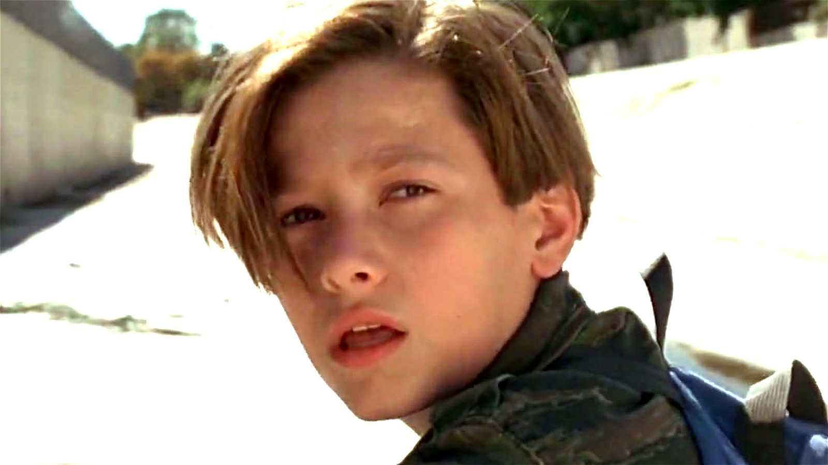
Main Characters.
John Connor
Sarah Connor
T-1000
T-800 Uncle Bob
His Father Kyle Reese died in Terminator 1.
The skynet believed that he was the strongest and he was going to destroy all the robots in future so it send a terminator T-1000 to kill him before he realise how special he was for the human race.
T-800 model 101 , was send by John himself through skynet to save himself.
She is the mother of John Connor.
She saviored the first terminator which was send to kill her with the help of kyle.
A shapeshifting android assassin.
Capable of making its on decisions contradicting to the ones of skynet.

Slide 7

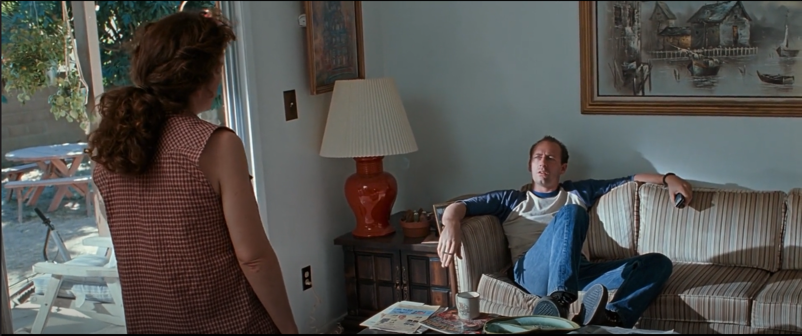
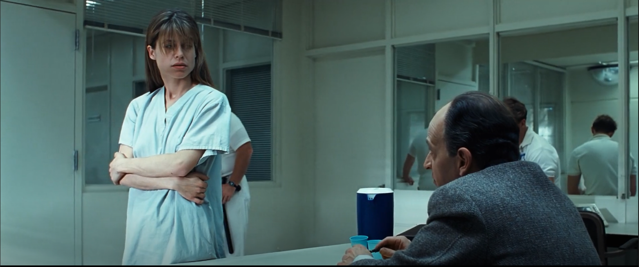
John’s Parents
John’s mother was captured for mental health disorder.
He was living with his foaster parents.
John Connor wake up facing new nightmare , the war against the machines.

Slide 8
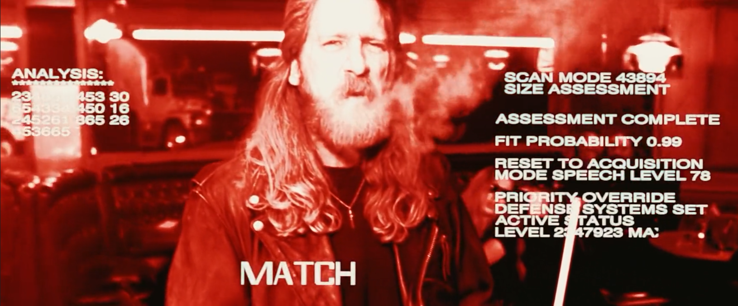
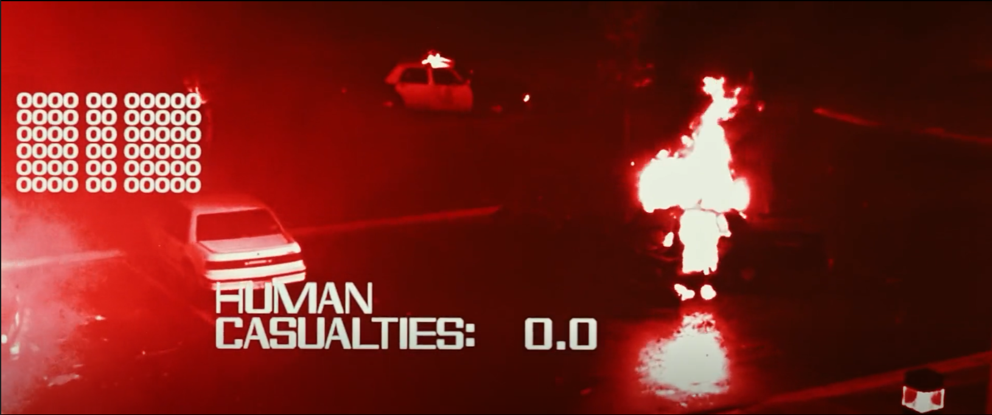
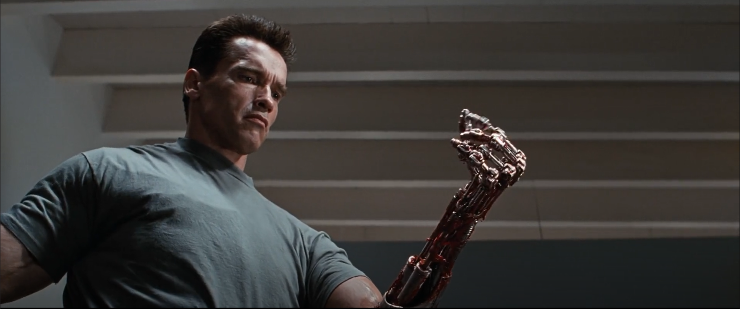
T-800
can see in the dark.
Uses red rays for vision.
Made of metal.

Slide 9
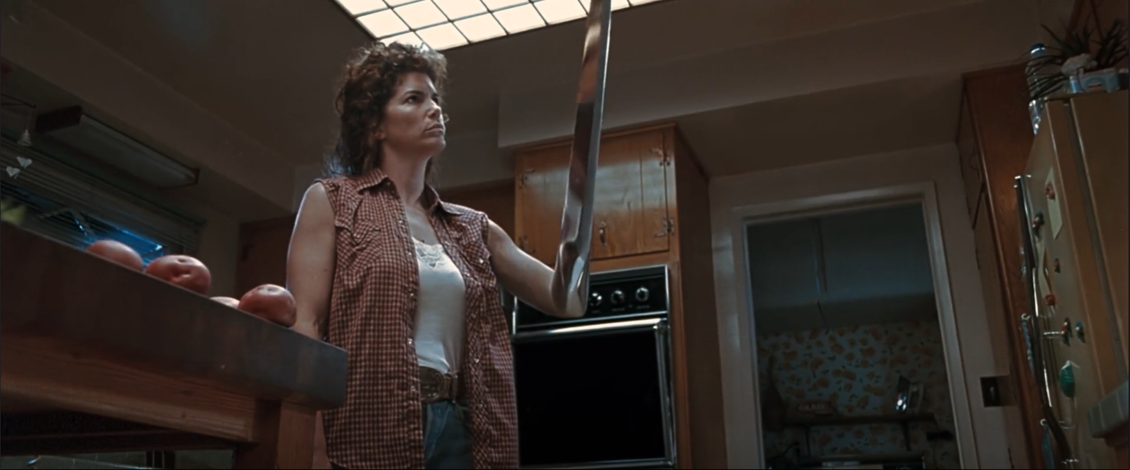
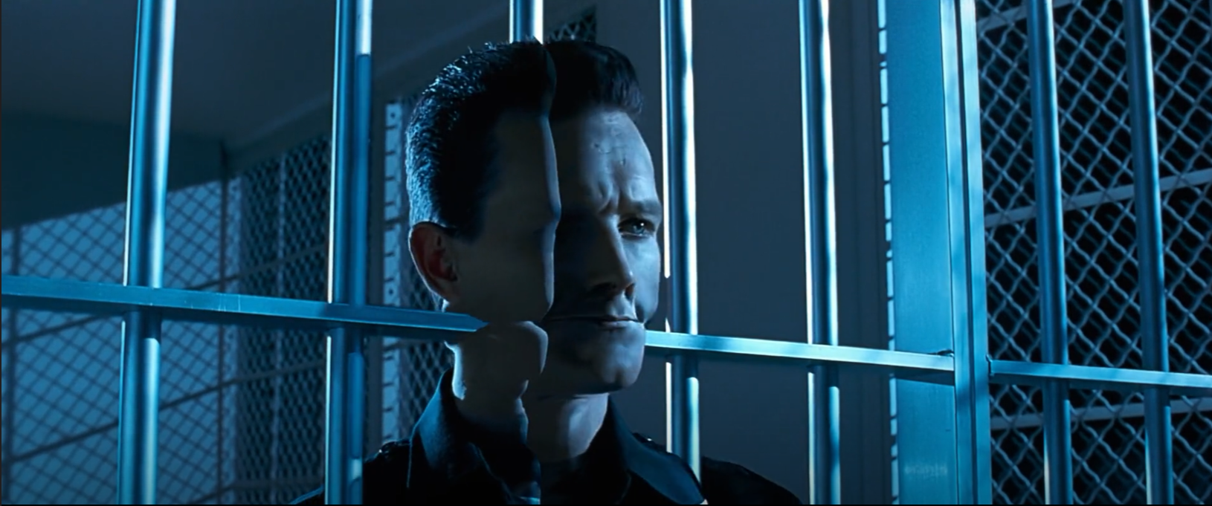
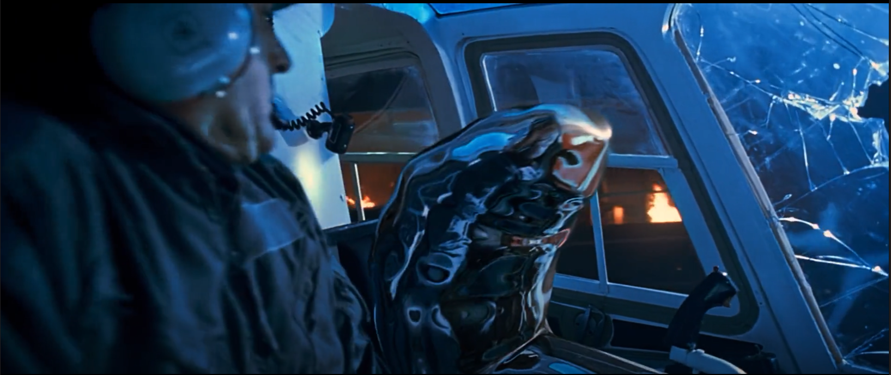
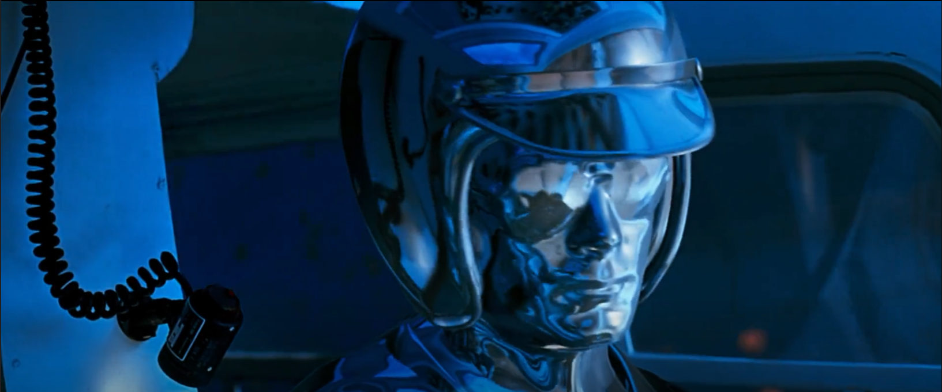
T-1000

Slide 10
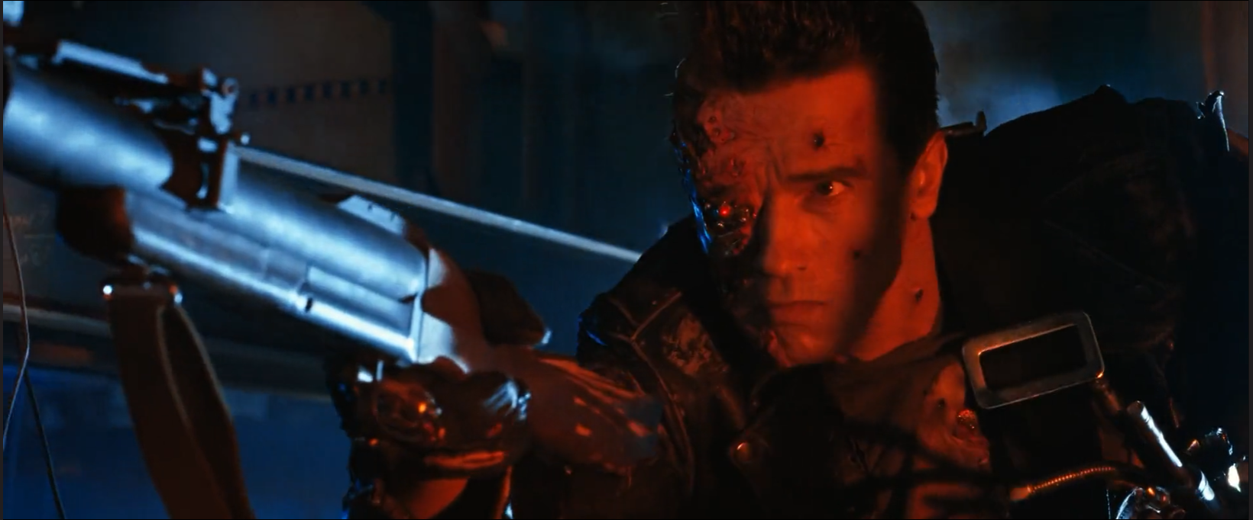
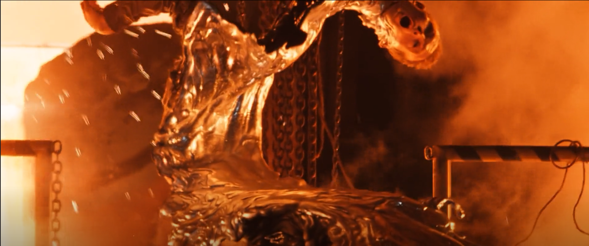
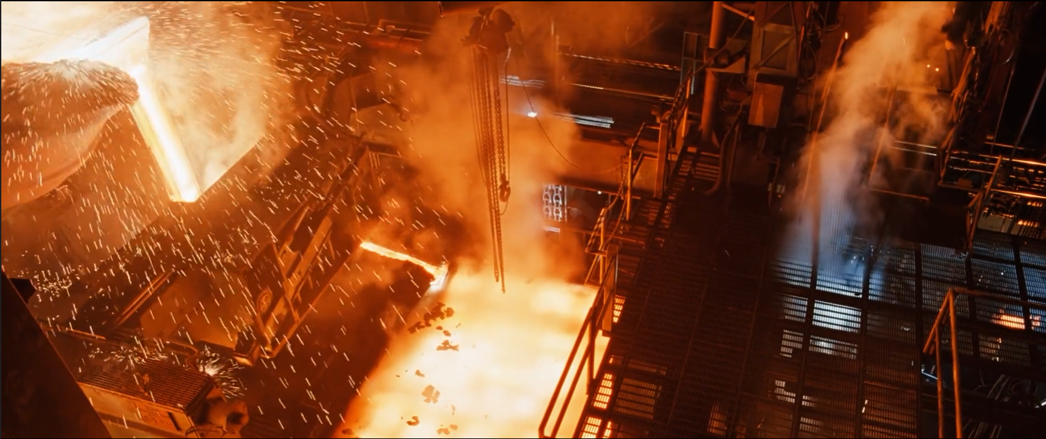
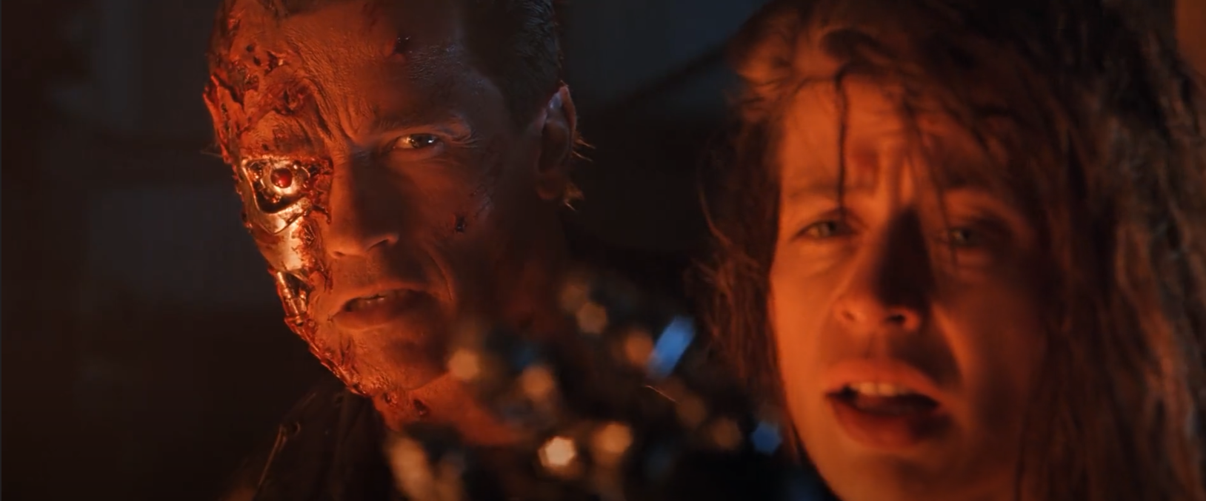
Last battle in the metal furnace

Slide 11
Conclusion
How effective was the opening scene for terminator 2 judgement day?
How much did this opening make you want to watch the rest of the film?
How much does the opening keep you guessing?
How much does the opening set the rest of the film up?

Slide 12
Do you have any questions?
Movie link:
https://musichq.cc/watch-movie/terminator-2-judgment-day-19609.6128659
THANK YOU!

